Slide 1
OA3103: Data Analysis
Exploratory Data Analysis (EDA) and Data Cleaning

Slide 2
References
EDA: Chapter 3 (Primary)
ISLP: Chapter 1

Slide 3
Objectives / Structure
Friday’s lab/HW introduced some basic data handling
Introduce data cleaning, numerical EDA, and Visual EDA
Build our data analysis cookbooks in Python and/or R

Slide 4
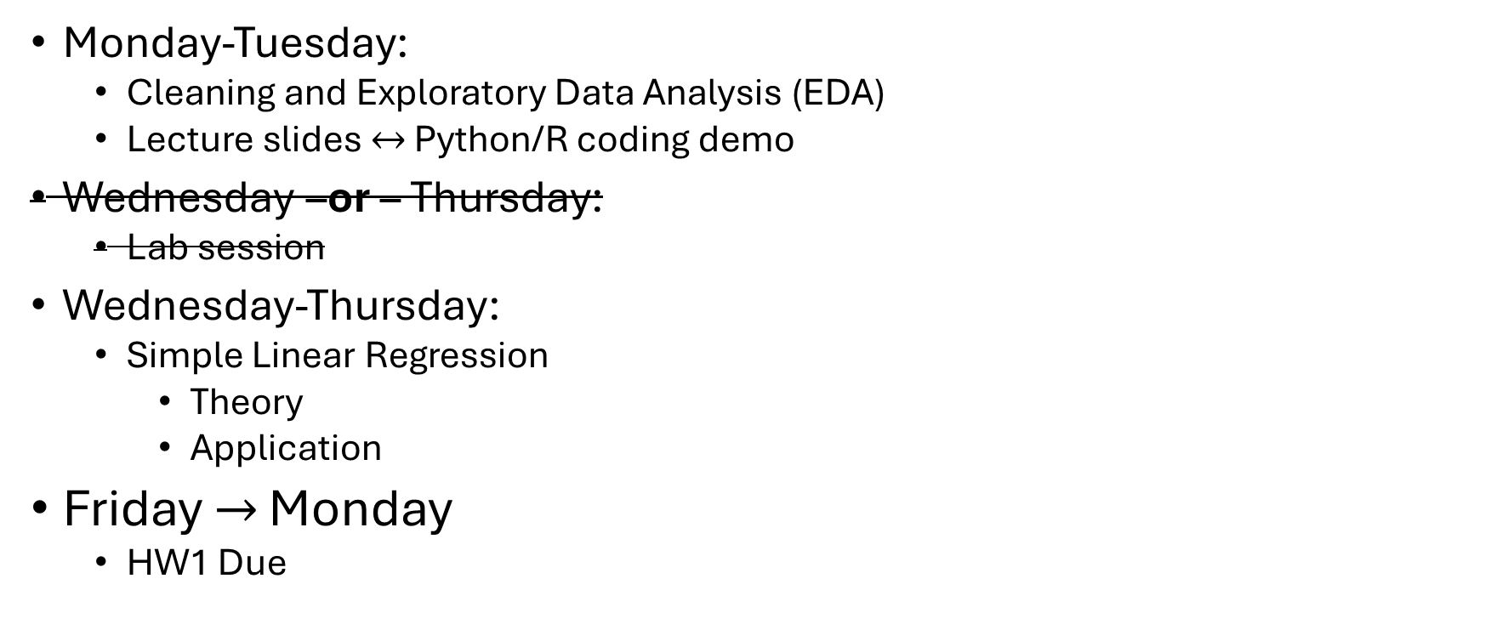
This Week’s Roadmap
Monday-Tuesday:
Cleaning and Exploratory Data Analysis (EDA)
Lecture slides $↔$ Python/R coding demo
Wednesday –or – Thursday:
Lab session
Wednesday-Thursday:
Simple Linear Regression
Theory
Application
Friday $→$ Monday
HW1 Due

Slide 5
Exploratory Data Analysis
Think of this as “listening to the data.”
Gain a big-picture understanding of what the data is telling us.
Do this before asking targeted questions of the data.

Slide 6
Variable types
A variable is any attribute which may change its value between observations in a data set.
Numeric variables:
Continuous:
Discrete:
Ordinal variables:
Categorical variables:

Slide 7
Variable types
A variable is any attribute which may change its value between observations in a data set.
Numeric variables: takes numbers as values
Continuous: Can take any value between its minimum and maximum.
ex: age, temperature
Discrete: Cannot take any value between its min and max; usually integers.
ex: number of ice cream flavors, number of Army and Air National Guard officers
Ordinal variables: Takes ordered categories as its values
ex: Enlisted ranks
Categorical variables: Takes unordered categories as its values
ex: Service branch, property view (“ocean”, “mountain”, etc.)

Slide 8
Why data cleaning?
Data can be messy/dirty. Why?
Data entry errors
Non-standardization
Notes:
Additional Reasons we need to clean data
Missing or Incomplete Data
Inconsistency with survey responses
Inconsistent Units or Scales – height in inches vs cm
Duplicates
Impossible values
Incorrect data types – numbers stored as strings, categories as integers, dates as text

Slide 9
Data Cleaning
Categorical variables may be recorded in an incorrect variable type in the dataset.
Example: Survey Responses
What is the “difference” between services?
Later: We will examine ways to encode categorical data numerically (binary, one-hot encoding, etc.)
Service Branch | Response
Army | 1
Marine Corps | 2
Navy | 3
Air Force | 4
Space Force | 5
Coast Guard | 6

Slide 10
Data Cleaning 101
Identifying and handling missing values
Fixing data types
Renaming and standardizing columns
Subsetting rows and columns
Detecting outliers
Basic sanity checks

Slide 11
Data Cleaning: Python and R tools
Loading a dataset as a Dataframe
Python:
import pandas as pd
df = pd.read_csv(“filename.csv”)
-or-
df = pd.read_csv(“filename.csv”, na_values=[“”, ”NA”, “N/A”])
R:
df <- read.csv(“filename.csv”)
-or-
df <- read.csv("filename.csv", na.strings = c("", "NA", "N/A"), stringsAsFactors = FALSE)

Slide 12
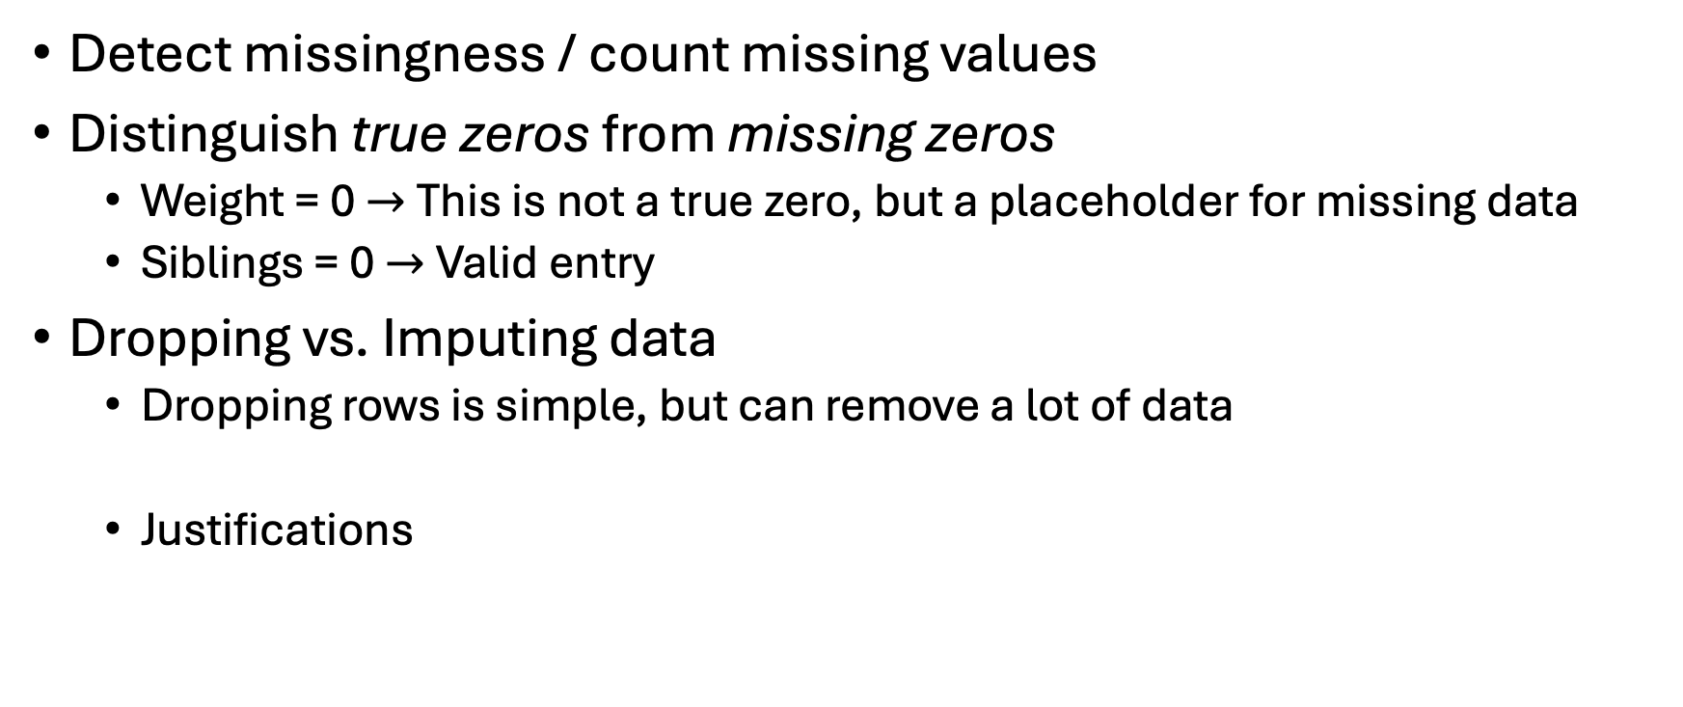
Identifying and handling missing values
Detect missingness / count missing values
Distinguish true zeros from missing zeros
Weight = 0 $→$This is not a true zero, but a placeholder for missing data
Siblings = 0 $→$Valid entry
Dropping vs. Imputing data
Dropping rows is simple, but can remove a lot of data
Justifications

Slide 13
Identifying and handling missing values
Python
df.isna().sum() Counts NaN values
df = df.replace(0, np.nan) Converts zeros to NaN
df = df.dropna() Removes rows containing at least one NaN
R:
colSums(is.na(df)) Counts NA values
df[df == 0] <- NA Converts zeros to NA
df <- drop_na(df) Removes rows containing at least one NA

Slide 14
Identifying and handling missing values
Dropping rows if specific columns are missing:
Python
df = df.dropna(subset=["Age", "Weight_lbs"])
R:
df <- drop_na(df, Age, Weight_lbs)

Slide 15
Identifying and handling missing values
Imputation: replacing missing values with reasonable substitutes so we don’t lose entire rows of data.
Ensure summaries and models can run
Dataset remains as representative as possible
Simple (Univariate) Imputation
Mean, Median, Mode, or replace with a constant
Intuitive but can distort distributions
Conditional (Multivariate) Imputation
Use other variables to make better guesses
Regression, k-nearest neighbors (kNN), predictive mean matching
Preserves relationships between variables, but complex and requires modeling assumptions
Multiple Imputation
Create several plausible datasets, analyze each, and combine results
Know when not to impute
Notes:
When not to impute? Ex: “Did not answer” is itself a category
When the variable isn’t needed
When missingness is too extensive
When imputation would introduce bias

Slide 16
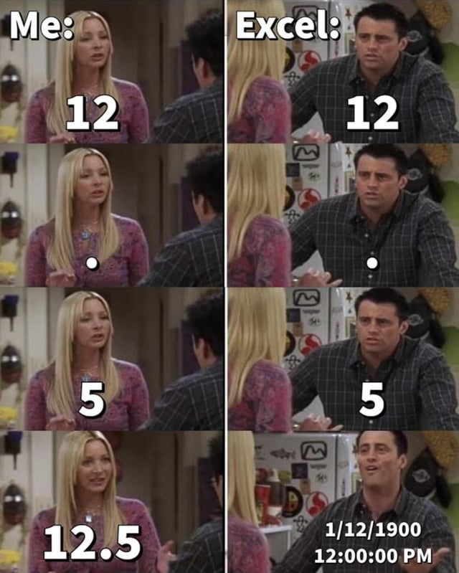
Fixing data types
Numeric columns read as strings
Categorical variables read as integers
Dates read as text

Slide 17
Detecting and Fixing data types
Python
df.dtypes
df["col"] = df["col"].astype(float)
df["category"] = df["category"].astype("category")
df["date"] = pd.to_datetime(df["date"])
R:
str(df)
df$col <- as.numeric(df$col)
df$category <- factor(df$category)
df$date <- as.Date(df$date, format = "%Y-%m-%d")
Technique: Import as strings first, clean values, then convert to numeric or factor once the column is trustworthy.

Slide 18
Renaming and standardizing columns
Nonstandardized column titling
“college” vs “school” vs “university”
“miles” vs “Miles_Driven”
Python:
df = df.rename(columns{“college”: “school”})
df = df.rename(columns{“Miles_Driven”: “miles”})
R:
df <- df %>% rename(school = college)
df <- df %>% rename(miles = Miles_Driven)

Slide 19
Subsetting rows and columns
Filter rows, select columns, or create new variables
Python
df[df["strength"] == 1]
df[["miles", "population"]]
df["mpd"] = df["miles"] / df["population"]
R
df %>% filter(strength == 1)
df %>% select(miles, population)
df <- df %>% mutate(mpd = miles / population)

Slide 20
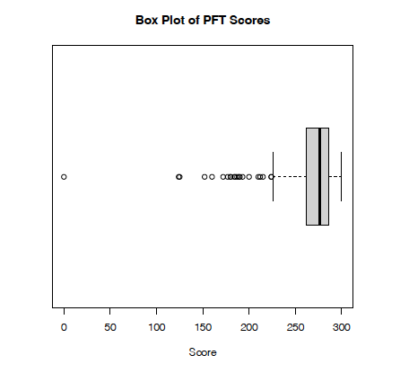
Detecting outliers
Outliers: Observations that are unusually far from the data, do not follow overall pattern
Also consider this during your visual EDA
Histograms
Boxplots
Scatterplots
Later: More techniques (e.g., leverage)
Look for these before you compute
You may be justified in cleaning (removing) outlier data
Remember: Repeatable and Defensible
Image source: EDA Example 3.5.2

Slide 21
Basic sanity checks
Prof. Alderson: “Be wary of taking data at face value, especially when you don’t know how it was generated.”
Are units consistent?
Are there impossible values?
Does the number of rows match our expectations?

Slide 22
Other Data Cleaning Tools
String cleaning
Trimming whitespace
Fixing capitalization
Standardizing Naming Conventions
e.g., “NYC” vs “New York City” or “LA” vs “Los Angeles”
Duplicate detection
Python: import pandas as pd R: library(dplyr)
df_unique = df.drop_duplicates() df_unique <- df %>% distinct()
df_cities = df.drop_duplicates(subset=["City", "State"]) df_cities <- df %>% distinct(City, State)
df_users <- df %>% distinct(UserID, .keep_all = TRUE) df_users = df.drop_duplicates(subset=["UserID"], keep="first")
Saving cleaned data
e.g., “Pima2” from Lab 1

Slide 23
Let’s go to Python/R
Sakai: montereyrecruiting.csv
Toy dataset
All characters are fictional, any resemblance to actual persons, living or dead, is purely coincidental.

Slide 24
Realities
Data-driven studies involve very large datasets
Ideally, errors fixed at the data entry point
Fix what we can
Standardize variable (column) names across datasets
Parse / remove nonsensical data
Numerical issues may be easier to spot
Summary statistics
Visual EDA
Our toy example: Errors can be an indicator of credibility of the data source
Maybe we need to find another dataset

Slide 25
Single Number Summary Statistics
Ways to characterize the entire distribution of a dataset variable into one number that answers a specific question about the data’s behavior.
Measures of Center
Measures of Spread
Measures of Shape
Measures of Extremes

Slide 26
Measures of Center
Mean: The center of mass, or “balance point.”
Sensitive to outliers.
Median: The middle value when data are ordered.
Robust to outliers.
Mode: The most common value.
Useful for categorical data.

Slide 27
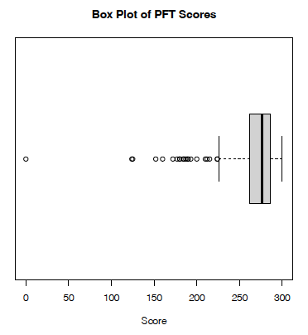

Measures of Spread
How variable are the data?
Range: Max – Min
Interquartile Range (IQR): $Q3−Q1$
Variance
Average squared deviation from the mean
Standard Deviation
Square root of variance
Useful for intuiting units of measure
Image source: EDA Example 3.5.2

Slide 28
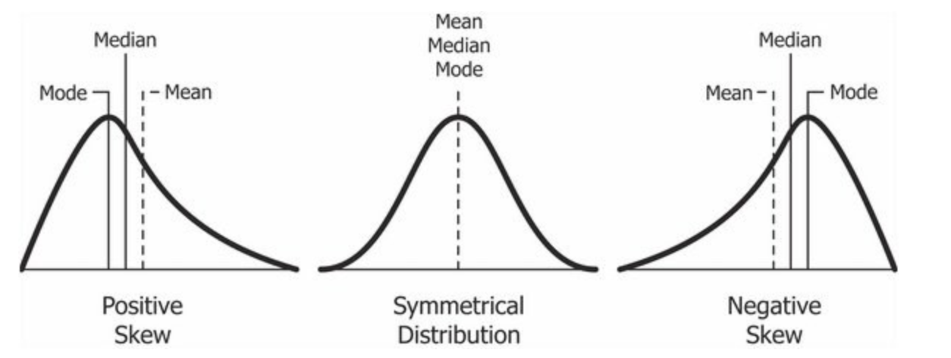
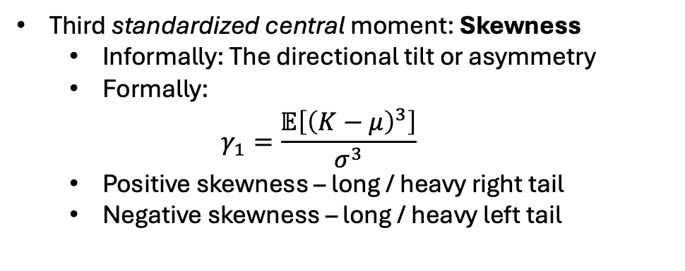
Measures of Shape
Third standardized central moment: Skewness
Informally: The directional tilt or asymmetry
Formally:
$$γ_{1}=\frac{𝔼\left[{\left(K−μ\right)}^{3}\right]}{σ^{3}}$$
Positive skewness – long / heavy right tail
Negative skewness – long / heavy left tail
Image source: Jain, D. “Relationship between mean and median under different skewness.png” CC BY SA-4.0.

Slide 29
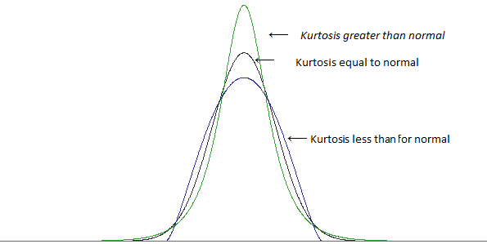

Measures of Shape
Fourth standardized central moment: Kurtosis
Informally: “Fatness” or tail weight
Formally:
$$γ_{2}=\frac{𝔼\left[{\left(K−μ\right)}^{4}\right]}{σ^{4}}$$
How much probability lives far from the mean
High kurtosis – more extreme values
Low kurtosis – fewer extremes
Excess Kurtosis: $γ_{2}−3$
Normal distribution has kurtosis 3
Image source: https://stats.stackexchange.com/questions/84158/how-is-the-kurtosis-of-a-distribution-related-to-the-geometry-of-the-density-fun

Slide 30
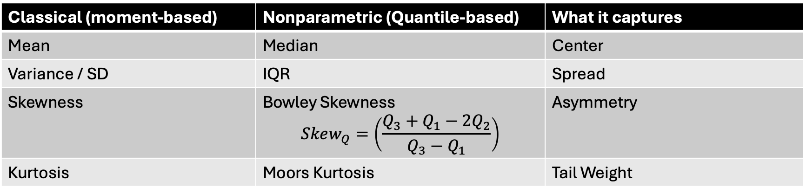
Nonparametric / Quantile Based Analogs
Some measures are more robust to outliers than others
Classical (moment-based) | Nonparametric (Quantile-based) | What it captures
Mean | Median | Center
Variance / SD | IQR | Spread
Skewness | Bowley Skewness $$Skew_{Q}=\left(\frac{Q_{3}+Q_{1}−2Q_{2}}{Q_{3}−Q_{1}}\right)$$ | Asymmetry
Kurtosis | Moors Kurtosis | Tail Weight

Slide 31
Measures of Extremes
Minimum
Maximum
Outlier Flags
Tukey fences: Named after John Tukey, who invented the box plot
Image source: EDA Example 3.5.2

Slide 32
Let’s go back to Python/R
Sakai: pft.csv

Slide 33
OA3103: Data Analysis
Exploratory Data Analysis (EDA) and Data Cleaning (Part II)

Slide 34
Visual EDA
So far we have focused on numbers to summarize the observations of a variable.
Visual EDA uses plots as a powerful tool to show the behavior of these observations.
We will tie the single-number summary statistics to this behavior.

Slide 35
Visual EDA - Categories
Categorize visual EDA into three types, based on how many variables we examine:
Univariate Data – behavior of a single variable (distributions)
ex:
Bivariate Data – behavior of the relationships between two variables
ex:
Multivariate Data –
Suggest interactions between two variables that affect a third
ex:
Patterns across many bivariate relationships at once
ex:

Slide 36
Visual EDA - Categories
Categorize visual EDA into three types, based on how many variables we examine:
Univariate Data – behavior of a single variable (distributions)
ex: ages, heights, service, communities
Bivariate Data – behavior of the relationships between two variables
ex: height vs weight
Multivariate Data –
Suggest interactions between two variables that affect a third
ex: effect of seniority and education on income
Patterns across many bivariate relationships at once
ex: Pairwise behaviors of height, weight, wingspan, and age

Slide 37
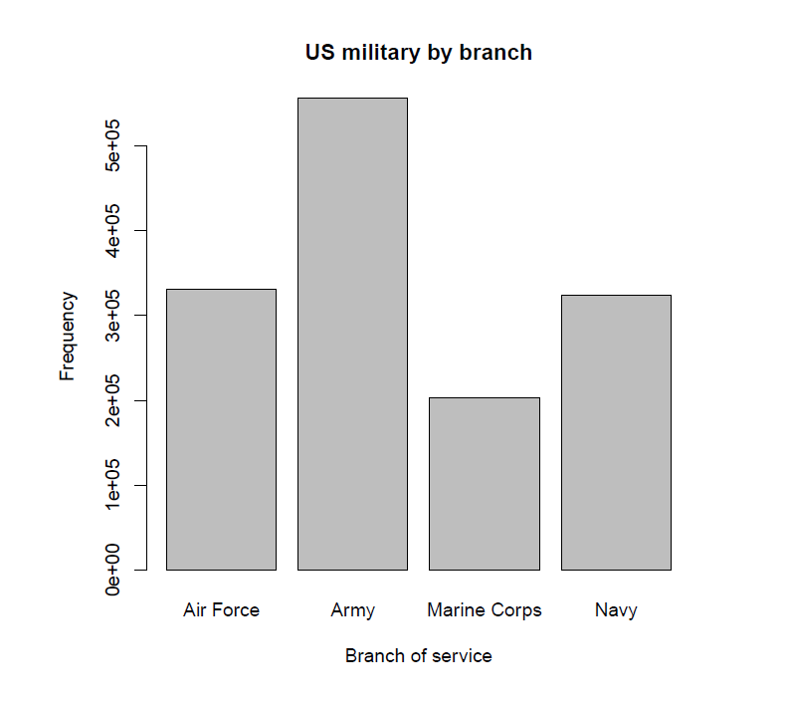
Univariate Data
Recommended plots per type of variable
Categorical data: Bar Plots
Numerical data: Histograms
Image source: EDA Example from the military dataset in the OIdata package (updated to the “openintro” package).

Slide 38
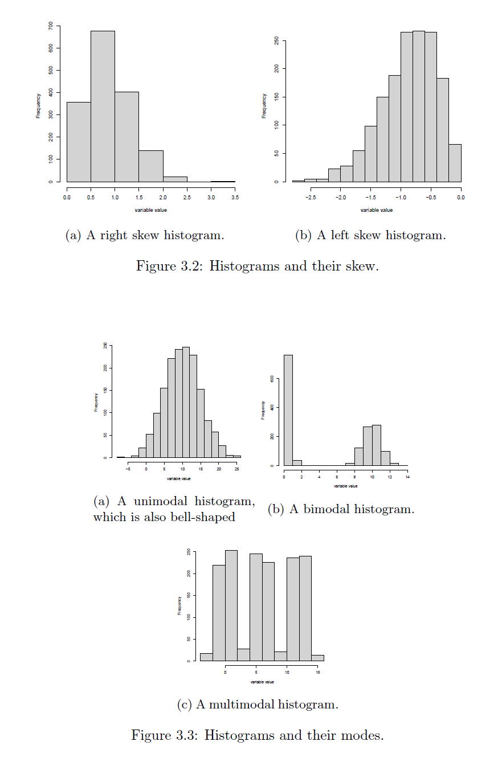
Histograms
Visually check:
Symmetry vs Skewness
Multimodality
Unimodal: single peak
Bimodal: two peaks
Multimodal: two or more peaks
Shape
Bell-shaped: Tells us what?
Image source: EDA Figures 3.2 and 3.3.

Slide 39
Applications of Standard Deviation
Empirical Rule:
If the histogram of a set of observations is bell-shaped, or approximately Gaussian (why would this happen?):
About 68% of observations lie within 1 standard deviation of the mean.
About 95% of observations lie within 2 standard deviations of the mean.
About 99.7% of the observations lie within 3 standard deviations of the mean.
Notes:
Bell curves show up for several reasons.
Sometimes it’s the Central Limit Theorem — many small additive effects.
- In physics, maximum entropy: if all we know is mean and variance, the most natural shape is the normal.
- Biology, symmetry and aggregation. The normal distribution is the ‘default’ shape of randomness.

Slide 40
Applications of Standard Deviation
What about when the data do not appear to be approximately normal?
We can generalize via Chebyshev’s Inequality:
For random variable $X$ with finite non-zero variance $σ^{2}$ and finite mean $μ$, for any real $k∈ℝ:$
$$P\left(\left|X−μ\right|≥kσ\right)≤\frac{1}{k^{2}}.$$
In (slightly more) English: For any $k>1$, at least $100\left(1−\frac{1}{k^{2}}\right)\%$ of the observations lie within $k$ standard deviations of the mean.

Slide 41
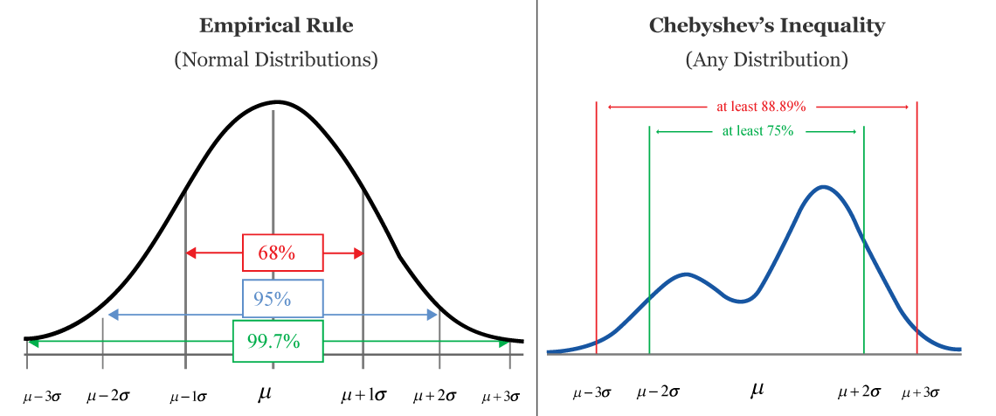
Applications of Standard Deviation
Empirical Rule gives us an approximate percentage of the data contained within a window of the mean.
Chebyshev gives a lower bound.
Image source: CalcWorkshop. Chebyshev’s Inequality. Retrieved from https://calcworkshop.com/joint-probability-distribution/chebyshev-inequality/

Slide 42
Bivariate Data
Examine the relationship between a pair of variables.
Recommended EDA plots by variable type $×$ variable type:
Data Types | Categorical / Ordinal | Numerical
Categorical / Ordinal | Grouped Bar Plot | Grouped Box plot
Numerical | Grouped Box Plot | Scatter Plot

Slide 43
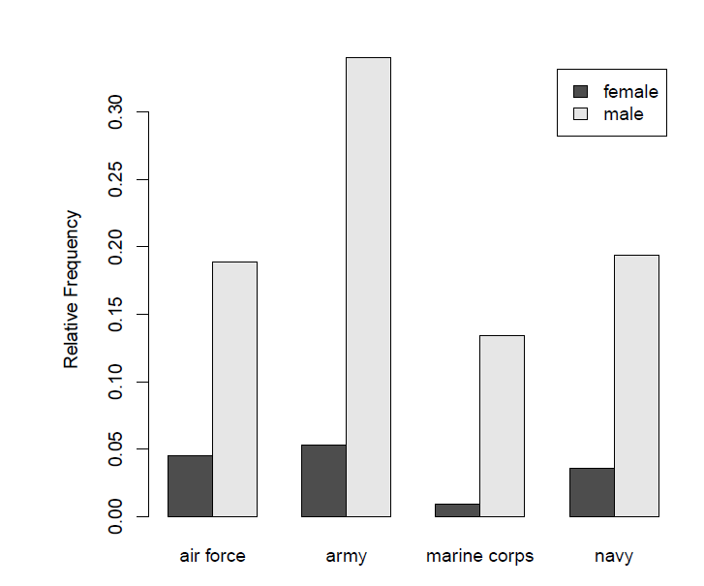
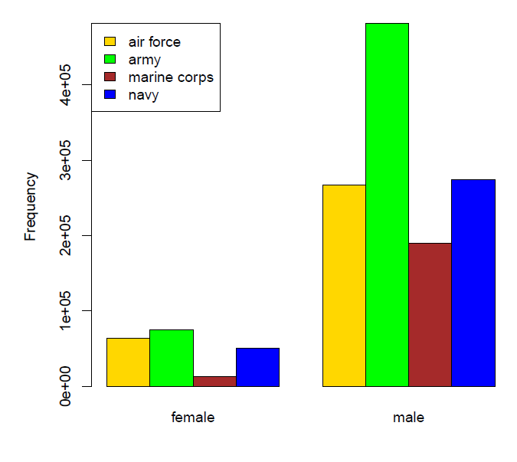
Grouped Bar Plots
Categorical / Ordinal $×$ Categorical / Ordinal
Image source: EDA Example from the military dataset in the OIdata package (updated to the “openintro” package).

Slide 44
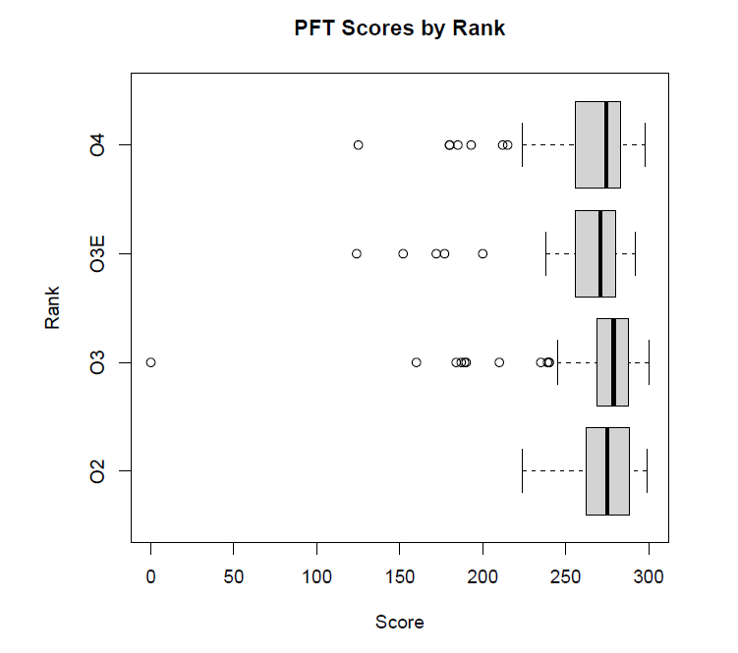
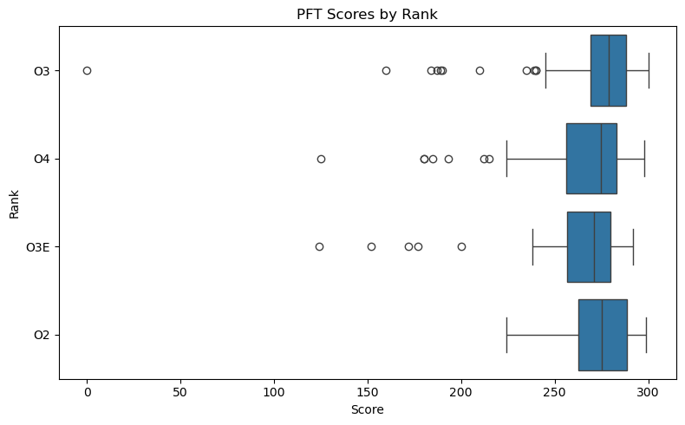
Grouped box plot
Categorical / Ordinal $×$ Numerical
R:
boxplot(pft_data$score ~ pft_data$rank, + horizontal=T, xlab=“Score”, ylab=“Rank”, + main=“PFT Scores by Rank”)
Python:
import seaborn as sns
import matplotlib.pyplot as plt
plt.figure(figsize=(8, 5))
sns.boxplot(
data=pft_data,
x="score", # horizontal axis
y="rank", # grouping variable
orient="h" # horizontal orientation
)
plt.xlabel("Score")
plt.ylabel("Rank")
plt.title("PFT Scores by Rank")
plt.tight_layout()
plt.show()
Image source: R (top) and Python/Seaborn (bottom) plots from the pft.csv dataset.

Slide 45
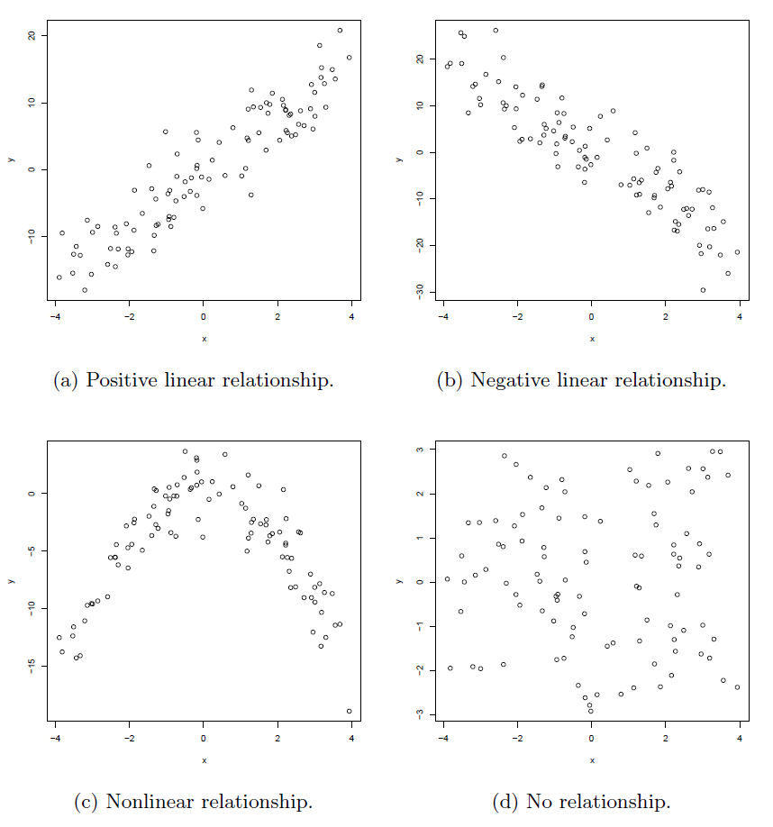
Scatterplots
Numerical $×$ Numerical
Image source: EDA Figure 3.8.

Slide 46
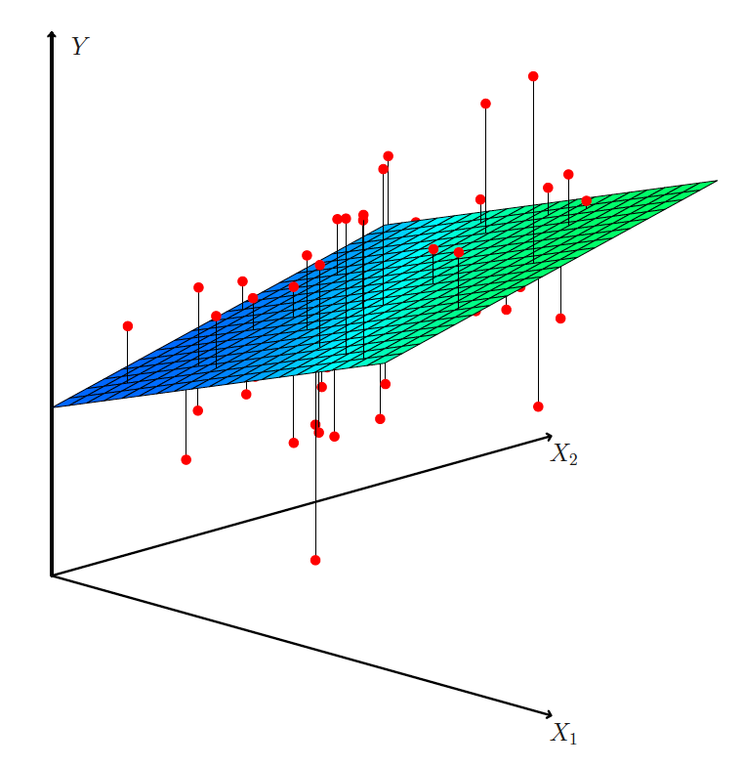
Multivariate Data
3d scatterplots
Scatterplot matrices
Correlation Heatmaps
Image source: ISLP Figure 3.4

Slide 47
Scatterplot matrices $→$ Correlation heatmaps
Not truly “multivariate”
Behavior of many variables together, often summarized through collections of pairwise relationships.
As the number of variables grows, pairwise plots become visually dense.
Heatmaps can summarize the same information more efficiently.

Slide 48
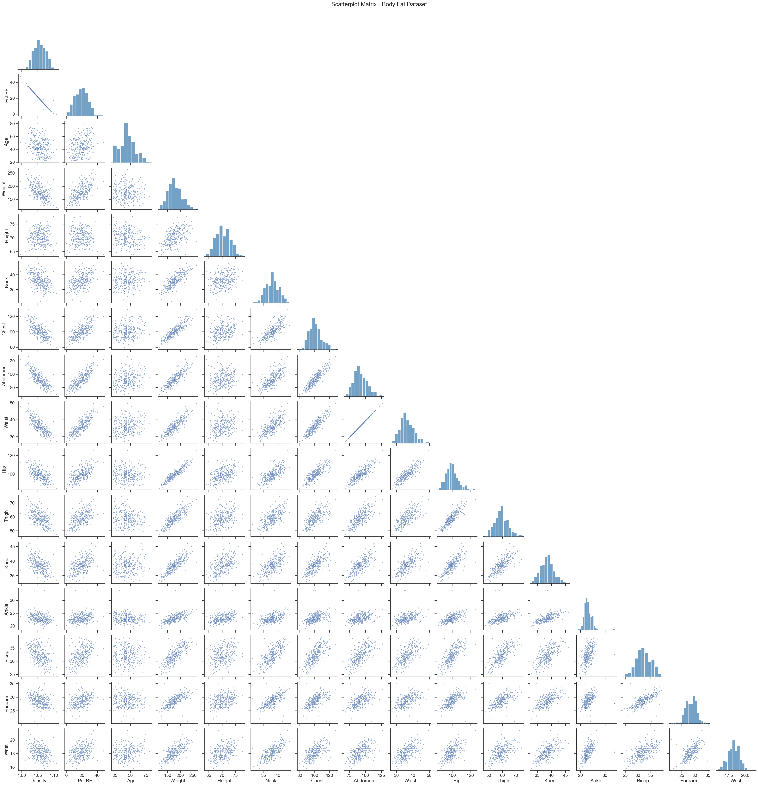
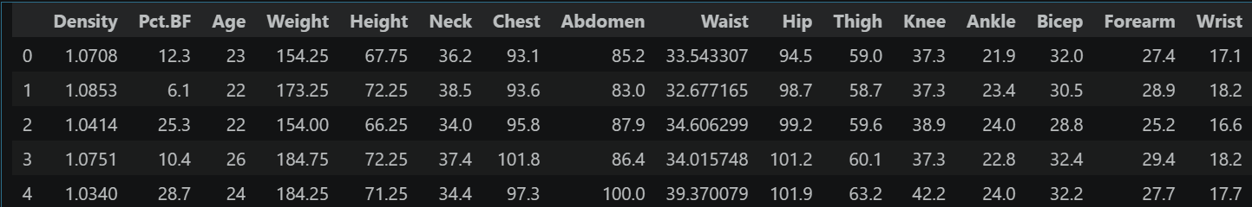
Scatterplot Matrix
Python:
head(body_fat)
16 numerical variables
Why are the diagonal entries histograms?

Slide 49
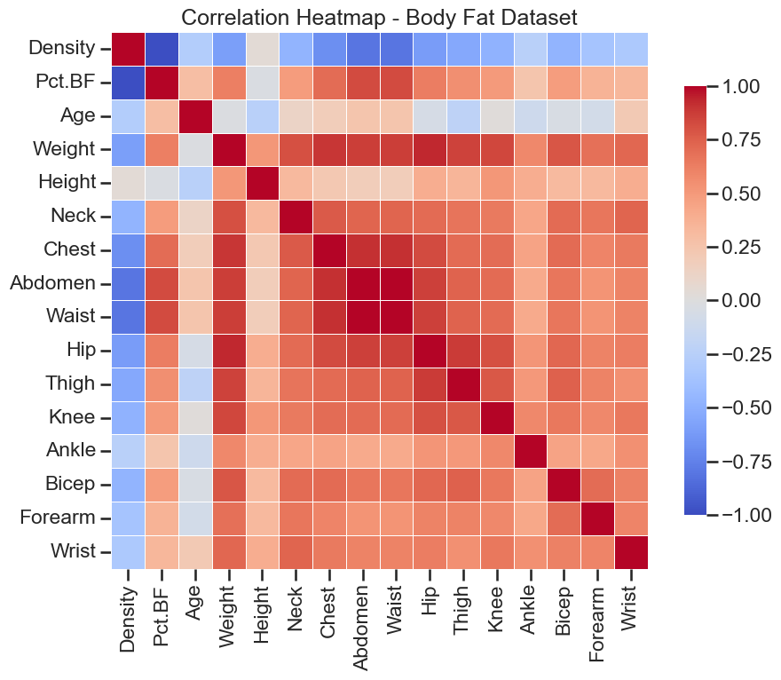
Correlation Heatmap
Recall from last week:
$$Cov\left(X,Y\right)=𝔼[\left(X−μ_{X}\right)\left(Y−μ_{Y}\right)]$$
Correlation $ρ_{XY}∈\left[−1,1\right]:$
$$ρ_{XY}=\frac{Cov\left(X,Y\right)}{\sqrt{Var\left[X\right]⋅Var[Y]}}$$
Why are the diagonal entries +1?

Slide 50
Back to Python/R
With the pft.csv data:
Build a histogram of the pft scores
Overlay the mean, median, and standard deviation lines
Verify the empirical rules and/or Chebyshev’s rule
Create a grouped boxplot of the score and gender variables.
Using the pima dataset from the faraway package:
Run a quick cleaning of the data
Zeros as missing: “triceps”, “insulin”, “bmi”
Create a correlation heatmap
(Time permitting) Save the clean pima data as a csv and create a pairplot and correlation heatmap in Python using seaborn

